Slide 1
INTRODUCTORY LECTURE

Slide 2
COURSE CODE: HMT801
COURSE NAME:
TRAVEL AGENCY AND TOUR OPERATIONS

Slide 3
Lecture Plan for Course
1. Lecture (L)= 3 per week
2. Tutorial (T)= 0 per week
3. Practical (P)= Nil
4. Credits (Cr.)= 3
L/T/P= 3/0/0

Slide 4
Course outcome
You (students) will be able to understand:
know the basics of travel and tourism manoeuvres
gain knowledge and skills for steering tour operations
apply the knowledge in tourism entrepreneurship
analyze the usage of technology in travel operations for wide networks and travel service efficiency
evaluate the sustainability in travel operations and activities of travel bodies and associations
develop an impactful tour package for successful travel operation

Slide 5
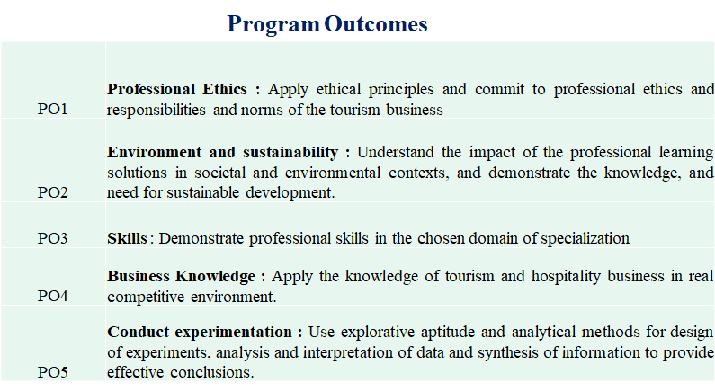

Slide 6
Overview of Course content
The course will focus on following topics:
1- Tourism system
2-Travel agency operations
3- Itinerary planning & tour packaging
4- Travel entrepreneurship and sustainable marketing
5- Travel bodies & associations
6- Technology in tour operations

Slide 7
Practical Application of the Course
1.Knowledge about the travel and tourism maneuvers will help learner to plan impactful tour packages
2.Course will help learner to integrate the technology and travel operations to give better output in the industry
3.Learner will be able to identify at least small scale business avenues for entrepreneurship through this course
4.This course allow learner to evaluate the travel operations and activities of travel bodies and associations for better sustainable service delivery and consumption.

Slide 8
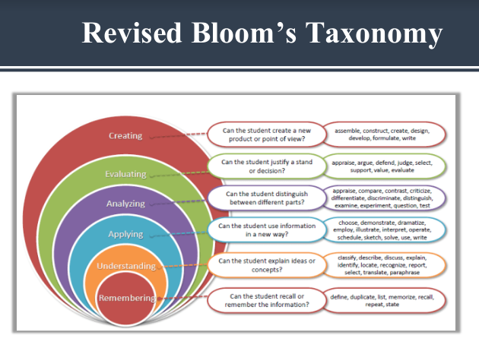

Slide 9
Text Book:
Travel Agency Management: An Introductory by Dr. Mohinder Chand
Tourism Operations And Management by Sunetra Roday, Archana Biwal & Vandana

Slide 10
EVALUATION PARAMETER
Continuous Assessment (CA):
Total Number of Assessment = 3
Best of 2 out of 3 will be taken
Every CA will be of 30 marks
Attendance carries 10 marks

Slide 11
Marks break up
Attendance 10
CA (Two best out of three tasks) 20
MTE 20
ETE 50
Total 100

Slide 12
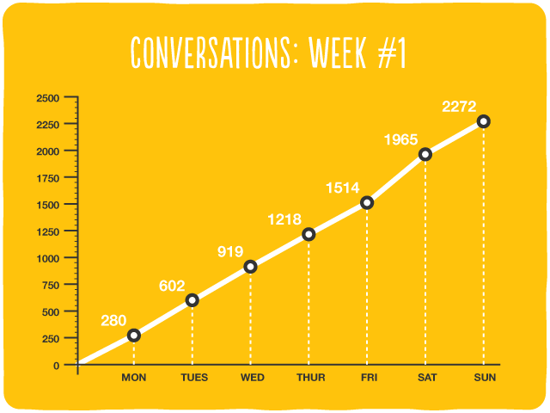
How
The above said topics will be taught with the help of:
PowerPoint Presentation
Discussion
Case Study
Question & Answers

Slide 13
Students Role
Students are advised to use instruction plan as rudder for their course study.
They are required to submit their assignments well on time.
Students are advised to visit the websites and other reference made in the instruction plan.
They are encouraged to take part in class discussions.
New information related to the topic being taught are also encouraged.
Constructive feedback with regard to the topics are welcomed.

Slide 14
First Lecture
Introduction to TATO business:
Meaning and concept of travel business, history of travel business, travel agency- definition and types, tour operator- definition and types, organizational structure of travel agency.

